Slide 1
Software Engineering
Module 5-b
Software Requirements Techniques
Use Case Modeling
Dr. Shai Koenig
Open University
Department of Computer Science

Slide 2
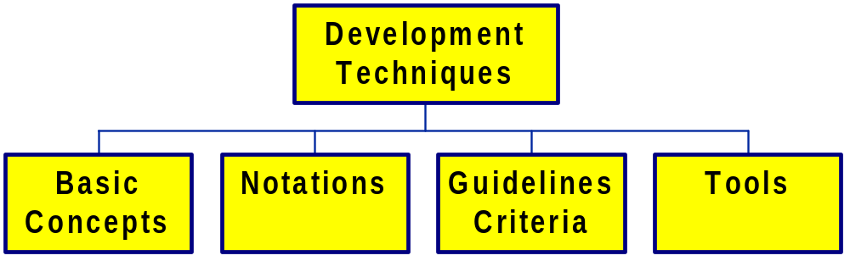
Development Techniques

Slide 3
Development Technique Dimensions
Data
Entity
Relationship
Modeling
Function
Use Case /
Scenario
Modeling
Control

Slide 4
The Use of Use Cases
In a survey of the techniques used for requirements elicitation, representations and modeling [see “Requirements Engineering: The State of Practice,” IEEE Software, Nov. 2003]
Over 50% of those surveyed used scenarios or use cases
This was the most common approach when any approach was used
In the same survey, only 30% of the surveyed population reported using OO analysis

Slide 5
UML - Unified Modeling Language
a language for software blueprints
addresses the different views of a system’s use, organization, structure and behavior
addresses both the conceptual and physical aspects of a system
the UML is not limited to modeling software systems
the UML is not a development process
The UML is a language for
  visualizing
  specifying
  constructing
  documenting
the artifacts of a software-intensive system.
Note: A software development process guides the project in deciding what work-products to produce, what activities and workers to use to create and manage these work-products, and how to use these work-products to plan, track and control the project as a whole.

Slide 6
Use cases address “how to make functional requirements readable, reviewable.”
1. Use cases describe functional requirements in an easy-to-read, easy-to-track, text format.
2. A use case collects how a goal succeeds / fails; a scenario shows one specific condition; scenarios & use cases nest.
3. Use cases show only the Functional req’ts.
4. They make a framework for non-functional requirements & project details.
5. Design is not done only in use case increments.
Notes:
Take your time on this slide. 4-5 min. is O.K.
Name the kinds of details that can be hung
- not described in the literature, but much appreciated
- be sure to say, later on, how the requirements form was appreciated both by the users (readable) and IS (not just a pile of paragraphs)
Name both that a use case “collects” and that “failures” useful and not documented in the literature.

Slide 7
Example - Requirements Context
customer
Cash
Machine
Main
Computer
Customer
Service
Representative
Cash Machine
Maintenance
Technician

Slide 8
Specifying the primary scenario
Scenario - a sequence of interactions, each of which is performed by either an actor or specification entity, that yields an observable result of value to a particular actor
No. Entity Inputs, Actions, Outputs Remarks
1. | Customer | Inserts customer bank card through the ATM’s card reader.
2. | ATM | Reads the bank id and account number from the customer’s card and requests the main computer to validate the bank id and account number.
3. | Main computer | Receives the request from the ATM, validates the bank id and account number, and returns a validation confirmation message to the ATM.
4. | ATM | Receives a validation confirmation message from the Main Computer and then prompts the customer to enter his code.
5. | Customer | Enters his card code.
6. | ATM | Validates the card code and prompts the customer to enter the withdrawal amount in multiples of 50 I.S.
7. | Customer | Enters the withdrawal amount.
8. | ATM | Requests approval from main computer of customer account and withdrawal amount.
9. | Main Computer | Approves the withdrawal and notifies the ATM of new balance.
10. | ATM | Delivers to the customer the cash, card, and a receipt showing the new balance; sends notification to the main computer and logs the transaction.

Slide 9
Using Sequence Diagrams to Specify Scenarios
Customer ATM Main Computer
Bank Card
Request to validate withdrawal
Withdrawal validation
Prompt to enter card code
Card code
Prompt to enter amount
Withdrawal amount
Request to approve withdrawal
Withdrawal approval, new balance
Cash, card, receipt
Final transaction notification

Slide 10
Exceptions
Things don’t always go as planned, for example
a customer may want to withdraw cash from a cash machine, BUT
the card has expired
the card appears on a blacklist
the card code that was entered is invalid
the account does not have sufficient funds to cover the withdrawal
the ATM does not have sufficient cash to cover the withdrawal
…
…

Slide 11
Primary scenario with exception points
No. Entity Inputs, Actions, Outputs Remarks
1. | Customer | Inserts customer bank card through the ATM’s card reader.
2. | ATM | Reads the bank id and account number from the customer’s card and requests the main computer to validate the bank id and account number.
3. | Main computer | Receives the request from the ATM, validates the bank id and account number, and returns a validation confirmation message to the ATM. | Ex: Card has expired Ex: Card has been blacklisted
4. | ATM | Receives a validation confirmation message from the Main Computer and then prompts the customer to enter his code.
5. | Customer | Enters his card code.
6. | ATM | Validates the card code and prompts the customer to enter the withdrawal amount in multiples of 50 I.S. | Ex: code is invalid
7. | Customer | Enters the withdrawal amount. | Ex: Insufficient cash in ATM
8. | ATM | Requests approval from main computer of customer account and withdrawal amount. | Ex: Insufficient funds in account
9. | Main Computer | Approves the withdrawal and notifies the ATM of new balance.
10. | ATM | Delivers to the customer the cash, card, and a receipt showing the new balance; sends notification to the main computer and logs the transaction.

Slide 12
Secondary [exception] scenario
No. Entity Inputs, Actions, Outputs Remarks
3.1.1 | Main computer | Determines that the bank card has expired. Returns a message to the ATM indicating that the card has expired and the date of expiration.
3.1.2 | ATM | Receives the expiration message. Displays the a suitable message on the screen indating that the card has expired and the date of expiration. Prompts the user to ternminate the session.
3.1.3 | Customer | Acknowledges the message and terminates the session
3.1.4 | ATM | Returns to the customer the expired card.

Slide 13
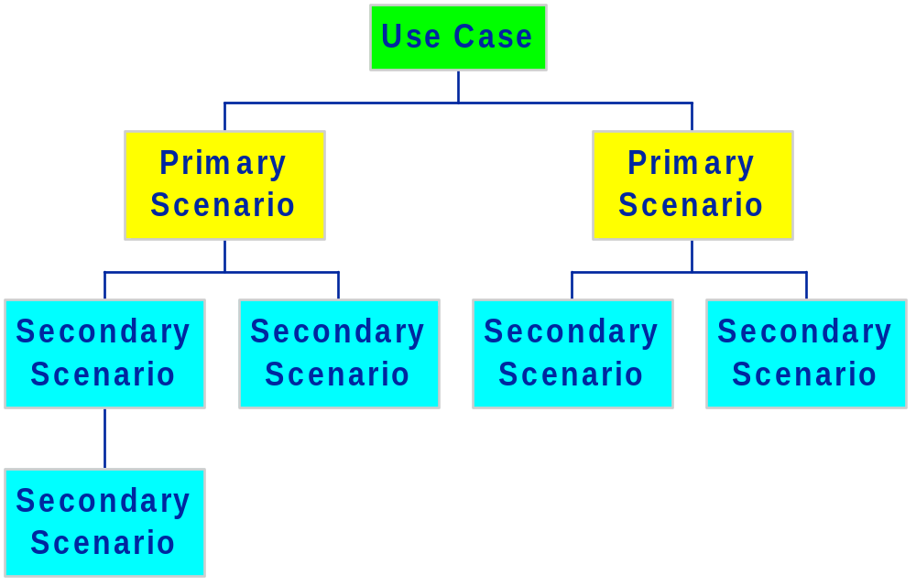
Use cases, primary scenarios and secondary scenarios

Slide 14
Example - Specifying a use case and its scenarios
UC Name | Withdraw cash from account
Goal | Use the cash machine to withdraw cash from a personal account.
Triggering Entity | Customer of one of the banks associated with the cash machine.
Triggering Event | Insertion of customer bank card
Precondition | The bank card belongs to one of the banks covered by the cash machine.
Success Postcondition | The customer receives his card, the requested cash, and a withdrawal receipt.
Failure Postcondition | The customer receives his card and a screen message explaining why the withdrawal failed.
Remarks

Slide 15
Example - Specifying a use case and its scenarios
Scenario Name | Withdraw cash from a cash machine
Scenario Type | Primary
Brief Description | Withdraw cash from a cash machine
Scenario Precondition | No additional preconditions
Scenario Postcondition | The customer has received the requested cash, his bank card and a withdrawal receipt.
Remarks | none

Slide 16
Primary scenario – “withdraw cash from a cash machine”
No. Entity Inputs, Actions, Outputs Remarks
1. | Customer | Runs bank card through the ATM’s card reader
2. | ATM | Reads the bank id and account number from the customer’s card and requests the main computer to validate the bank id and account number.
3. | Main computer | Validates the bank id and account number. | Ex: Card has expired Ex: Card has been blacklisted
4. | ATM | Prompts the customer to enter his code.
5. | Customer | Enters his card code.
6. | ATM | Validates the card code and prompts the customer to enter the withdrawal amount in multiples of 50 I.S. | Ex: code is invalid
7. | Customer | Enters the withdrawal amount. | Ex: Insufficient cash in ATM
8. | ATM | Requests approval from main computer of customer account and withdrawal amount. | Ex: Insufficient funds in account
9. | Main Computer | Approves the withdrawal and notifies the ATM of new balance.
10. | ATM | Delivers to the customer the cash, card, and a receipt showing the new balance; sends notification to the main computer and logs the transaction.

Slide 17
Example - Specifying a use case and its scenarios
Scenario Name | Withdraw cash from a cash machine with an expired bank card
Scenario Type | Secondary - extension
Brief Description
Scenario Precondition | The bank card used for the withdrawal has expired.
Scenario Postcondition | The customer has received his bank card and a message informing him of the expiration date of his card.
Remarks | none

Slide 18
Primary scenario – “withdraw cash from a cash machine”
No. Entity Inputs, Actions, Outputs Remarks
3.1.1 | Main computer | Determines that the bank card has expired. Returns a message to the ATM indicating that the card has expired and the date of expiration.
3.1.2 | ATM | Receives the expiration message. Displays the a suitable message on the screen indating that the card has expired and the date of expiration. Prompts the user to ternminate the session.
3.1.3 | Customer | Acknowledges the message and terminates the session
3.1.4 | ATM | Returns to the customer the expired card.

Slide 19
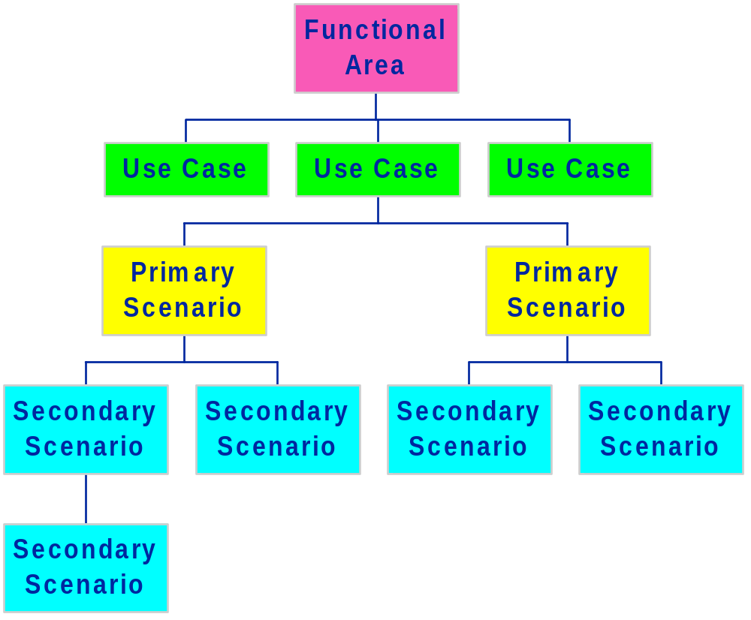
Grouping Use cases

Slide 20
Example – Use Case Diagram
Withdraw
cash from
account
customer
Inquire about
withdrawal
Customer
Service
Representative
Add cash to
cash machine
Cash Machine
Maintenance
Technician

Slide 21
Basic Concepts – Requirements Context
Actor
Entities
Specification
Interfaces

Slide 22
Basic Concepts
Actor entities
The external entities [e.g., humans, hardware, other systems] with which the “system” interacts.
Specification entities
The system components whose requirements are being specified.
User Scenario
a sequence of actions, each of which is performed by either an actor or specification entity, that yields an observable result of value to a particular actor
an instance of using the system
  primary
  secondary [often resulting from exception or error conditions]
Use case
set of scenarios with a common goal
the functionality of a “system” may be defined by a collection of use cases, each of which consists of a number of scenarios
use cases define a “system’s” functionality from the user’s [actor’s] point of view, without specifying how the use cases are implemented

Slide 23
Describing a use case
Use Case
Name
Goal/Brief description
Triggering Entity
Triggering Event
Precondition
Postconditions [success, failure]
Remarks
Scenario
Name
Brief description
Type [primary, secondary]
Precondition
Flow of events
Scenario
Name
Brief description
Type [primary, secondary]
Precondition
Flow of events
...

Slide 24
Describing a scenario’s flow of events
narrative prose
pseudocode
structured prose
  tables
interaction diagrams
  sequence diagrams
  collaboration diagrams

Slide 25
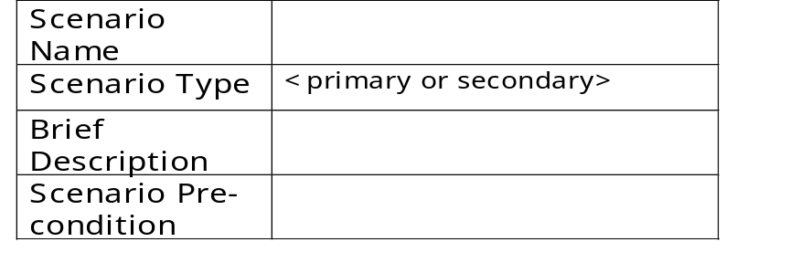
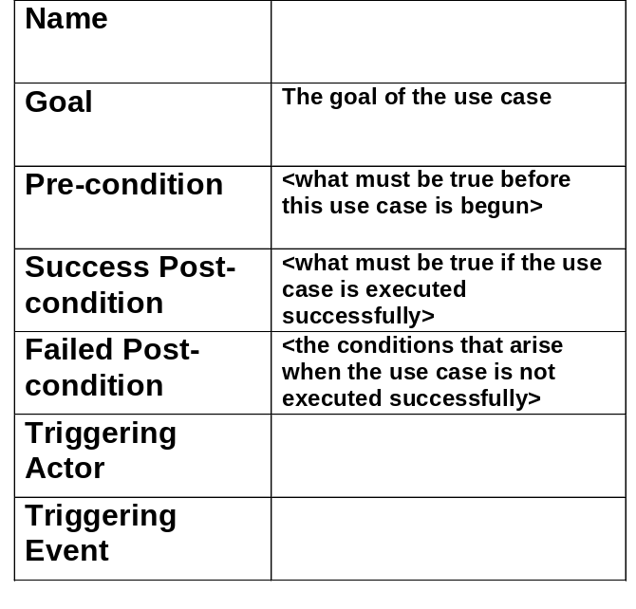
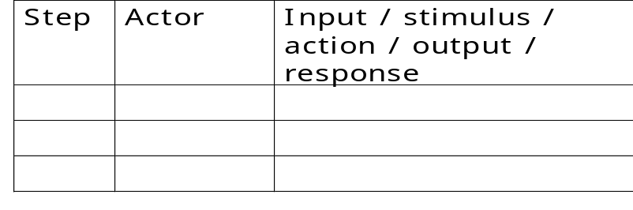
Specifying a use case and its scenarios
Scenarios
Use Case

Slide 26
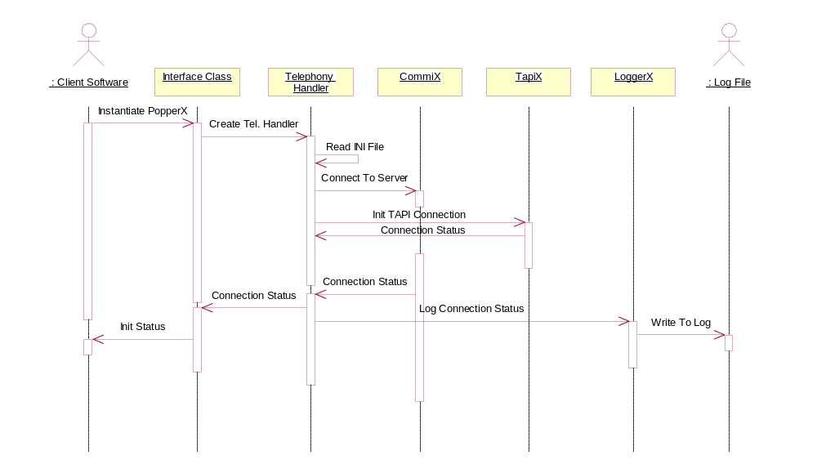
Sequence diagrams

Slide 27
Organizing use cases
you can organize use cases by grouping them into packages representing
  functional areas
  viewpoints
use case diagrams
you can organize use cases by specifying relationships among them
  generalization - use cases that are specialized versions of other use cases
  include - use cases that are included as parts of other use cases
  extend - use cases that extend the behavior of other use cases
<<include>>
<<extend>>
<<include>>

Slide 28

Use Case Diagram Notation
use-case
actor
stereotyped
actor
association

Slide 29
Beware - these are easily confused !
<<include>>
<<extend>>
<<include>>
Context diagram
Use case diagram

Slide 30
Guidelines for using use cases
DO
Use use cases/scenarios to specify behavioral requirements of
  an entire system,
  a specific subsystem
  a collection of subsystems
Start, by Identifying actors and their needs and the external events to which the “system” must respond.
Name use case with short active verb phrases naming some behavior requested/initiated by the actors of the unit(s) under specification.
DON’T
Overuse use cases
  by partitioning a use case into scenarios
  making use cases end-to-end
Duplicate across use cases
  By exploiting the “include” relationship
Include user interface design in use cases
Include detailed data definitions in use cases
Attempt to force all requirements into a use case framework

Slide 31
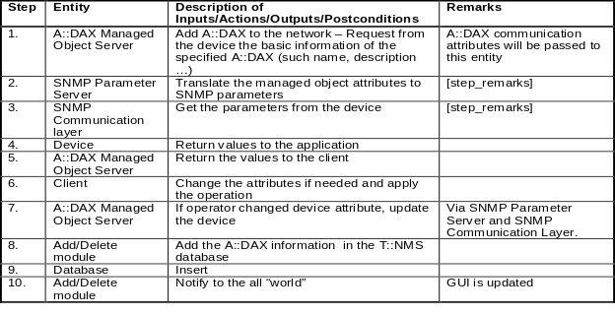
Requirements Specification Process
using Use Cases
System / Software
Requirements
Funtional
Requirements
Scenario
Fragments
Non-functional
Requirements
Context
Context Diagram
Functional
Area
Functional
Area
Scenario
Fragment
Scenario
Fragment
Non-functrional
Area
Non-functional
Area
Actor Entities
Specification Entities
Interfaces
Req
Use Case
Use Case
Subarea
Subarea
Req
Scenario
Scenario
Use Case
Use Case

Slide 32
Uses cases
Advantages
structure functional requirements in an user-oriented, easy-to-read manner
provide a suitable basis for communication between users, domain experts and developers
Provides context for requirements and precludes “orphan” functionality
provide a basis for planning development increments
provide a basis for test planning and execution
Disadvantages
not based on a formal language
lacks standardization
does not specify “system” wide, non-functional requirements
encourages unnecessary repetition

Slide 33
Summary of the Use Case Approach
Use cases define behavioral requirements
  from an “external” viewpoint
  in terms of goals
  that are achieved [or not] by end-to-end scenarios [sequences of actor/specification entity interactions]
Use cases define only the functional requirements and provide a framework for defining non-functional requirements
Use cases describe functional requirements in a more structured yet informal manner
  easier to write
  easier to read/understand
  self-organizing
  preclude “orphan” functionality
  easier to transform into test cases
  specify actor responsibilities as well

Slide 34
Tools
Rational Rose / Analyst Studio
  www.rational.com
Rhapsody
  www.ilogix.com
EIMS
...

Slide 35
Summary - Use Cases
actor entities
specification entities
use cases
scenarios
packages
...
Rational Rose
iLogix Rhapsody
EIMS
...
prose scenario specification
tabular scenario specification
sequence diagrams

Slide 36
References
Object-Oriented Software Engineering - A Use Case Driven Approach,
Jacobson, Christerson, Jonsson, Overgaard, Addison-Wesley.
The Unified Modeling Language User Guide,
Booch, Rumbaugh and Jacobson, Addison-Wesley
Applying Use Cases - A Practical Guide
Schneider and Winters, Addison-Wesley.
Goals and Use Cases,
Alistair Cockburn , Journal of Object Oriented Programming, Sept. 1997
Using Goal-Based Use Cases
Alistair Cockburn, Journal of Object Oriented Programming, Nov./Dec. 1997
UML Web Sites
  www.omg.org
  www.rational.com/uml
  www.ilogix.com
  www.systemhouse.mci.com

